Slide 1
Lecture 10 Bitcoin blocks and P2P Network

Slide 2
The real deal: a Bitcoin block
{
"hash":"00000000000000001aad2...",
"ver":2,
"prev_block":"00000000000000003043...",
"time":1391279636,
"bits":419558700,
"nonce":459459841,
"mrkl_root":"89776...",
"n_tx":354,
"size":181520,
"tx":[
...
],
"mrkl_tree":[
"6bd5eb25...",
...
"89776cdb..."
]
}
block header
transaction data

Slide 3
The real deal: a Bitcoin block header
{
"hash":"00000000000000001aad2...",
"ver":2,
"prev_block":"00000000000000003043...",
"time":1391279636,
"bits":419558700,
"nonce":459459841,
"mrkl_root":"89776...",
...
}
mining puzzle information

Slide 4
The real deal: coinbase transaction
"in":[ { "prev_out":{ "hash":"000000.....0000000", "n":4294967295 },
"coinbase":"..." }, "out":[ {
"value":"25.03371419", "scriptPubKey":"OPDUP OPHASH160 ... ”
}
redeeming nothing
Null hash pointer
First ever coinbase parameter:
“The Times 03/Jan/2009 Chancellor on brink of second bailout for banks”
arbitrary
block reward
transaction fees

Slide 5
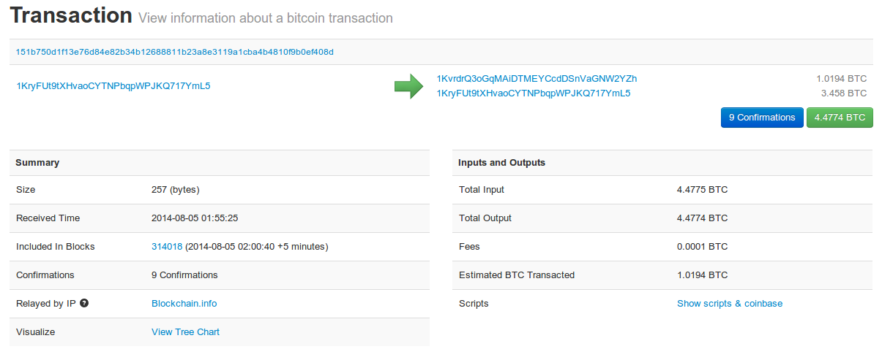
See for yourself!
blockchain.info (and many other sites)

Slide 6
The Bitcoin network

Slide 7
Bitcoin P2P network
Ad-hoc protocol (runs on TCP port 8333)
Ad-hoc network with random topology
All nodes are equal
New nodes can join at any time
Forget non-responding nodes after 3 hr

Slide 8
Joining the Bitcoin P2P network
5
1
Hello World! I’m ready to Bitcoin!
7
8
getaddr()
getaddr()
1, 7
getaddr()
3
6
2
4
Notes:
No geographic topology
Seed nodes
No formal way of leaving

Slide 9
Transaction propagation (flooding)
Already heard that!
5
1
7
8
A→B
A→B
A→B
New tx!
A→B
3
6
A→B
2
A→B
A→B
A→B
4
A→B
A→B
A→B
Notes:
Transactions are propagated in the “pending transaction pool”

Slide 10
Should I relay a proposed transaction?
Transaction valid with current block chain
(default) script matches a whitelist
Avoid unusual scripts
Haven’t seen before
Avoid infinite loops
Doesn’t conflict with others I’ve relayed
Avoid double-spends
Sanity checks only...
Some nodes may ignore them!

Slide 11
Nodes may differ on transaction pool
New` tx!
A→C
5
1
A→C
A→B
A→C
7
A→C
A→C
8
A→C
A→B
A→B
A→B
3
6
2
A→B
A→B
A→B
4
A→B

Slide 12
Race conditions
Transactions or blocks may conflict
Default behavior: accept what you hear first
Network position matters
Miners may implement other logic!

Slide 13
Block propagation nearly identical
Relay a new block when you hear it if:
Block meets the hash target
Block has all valid transactions
Run all scripts, even if you wouldn’t relay
Block builds on current longest chain
Avoid forks
Sanity check
Also may be ignored...

Slide 14
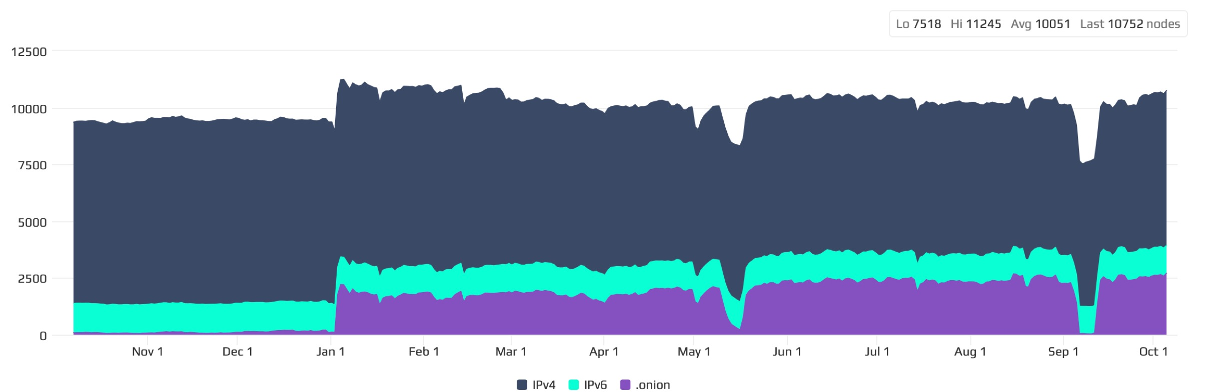
How big is the network?
https://bitnodes.io/dashboard/?days=365

Slide 15
How big is the network?

Slide 16
Fully-validating nodes
Permanently connected
Store entire block chain
Hear and forward every node/transaction

Slide 17
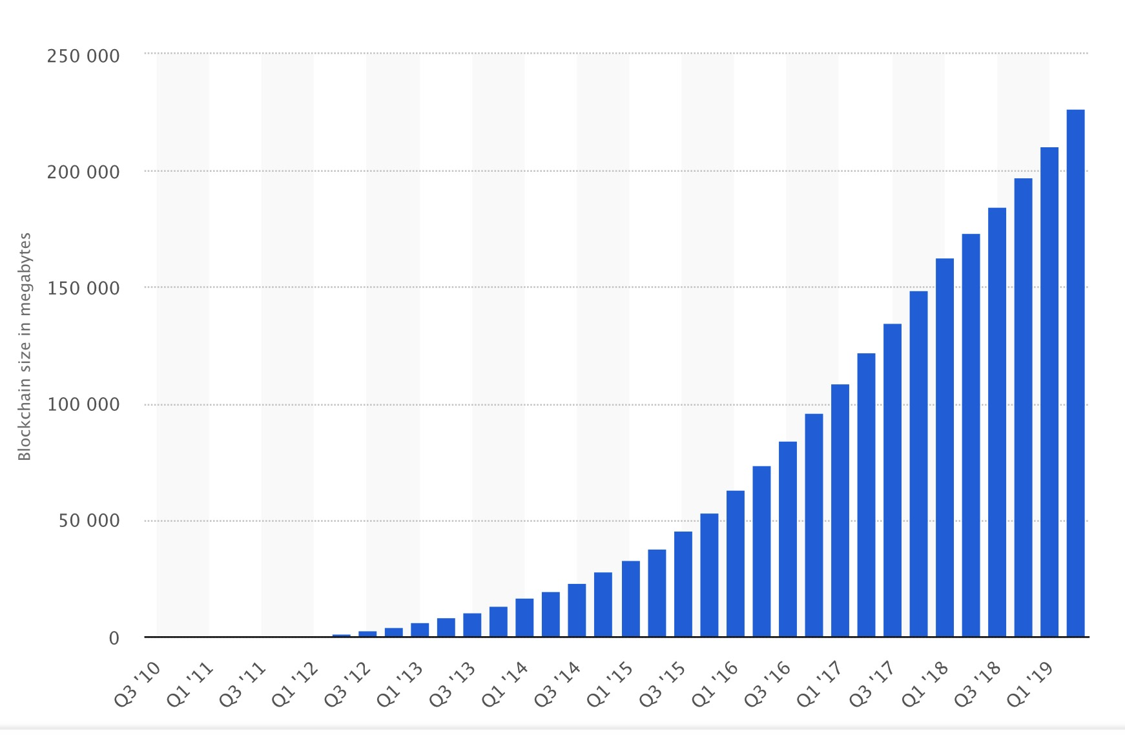
Storage costs

Slide 18
Thin/SPV clients (not fully-validating)
Idea: don’t store everything
Store block headers only
Request transactions as needed
To verify incoming payment
Trust fully-validating nodes
1000x cost savings! (20 GB-23MB)
Notes:
Also called “lightweight nodes”

Slide 19
Software diversity
About 90% of nodes run “Core Bitcoin” (C++)
Some are out of date versions
Other implementations running successfully
BitcoinJ (Java)
Libbitcoin (C++)
btcd (Go)
“Original Satoshi client”
Notes:
Core Bitcoin == “Satoshi “client
Original Satoshi client=historical only

Slide 20
Limitations & improvements

Slide 21
Hard-coded limits in Bitcoin
10 min. average creation time per block
1 M bytes in a block
20,000 signature operations per block
100 M satoshis per bitcoin
23M total bitcoins maximum
50,25,12.5... bitcoin mining reward

Slide 22
Throughput limits in Bitcoin
1 M bytes/block (10 min)
>250 bytes/transaction
7 transactions/sec ☹
Compare to:
VISA: 2,000-10,000 transactions/sec
PayPal: 50-100 transaction/sec

Slide 23
Cryptographic limits in Bitcoin
Only 1 signature algorithm (ECDSA/P256)
Hard-coded hash functions
Crypto primitives might break by 2040...

Slide 24
“Hard-forking” changes to Bitcoin
5
1
Block 24
Block 23
Block 23
7
8
Block 24
That’s crazy talk!!
Block 23
That’s crazy talk!!
Block 24
Block 23
24
I found a nifty new block!
3
6
24
2
Block 23
Block 24
Block 23
Block 23
24
4
24
Block 24
PROBLEM: Old nodes will never catch up
Block 23

Slide 25
Hard forks
New op codes
Changes to size limits
Changes to mining rate
Many small bug fixes
Currently seem very unlikely to happen

Slide 27
Hard-Forks
They are backward-incompatible software updates.
Happens when nodes add new rules in a way that conflicts with the rules of old nodes.
New nodes can only communicate with others that operate the new version.
As a result, the blockchain splits, creating two separate networks: one with the old rules, and one with the new rules.

Slide 28
Bitcoin Cash
The 2017 fork saw Bitcoin fragmented into two separate chains – the original one, Bitcoin (BTC), and a new one, Bitcoin Cash (BCH).
Bitcoin Cash proponents wanted to increase the block size which requires modification of the rules.
Old nodes would only accept blocks smaller than 1MB. If you created a 2MB block that was otherwise valid, other nodes would still reject it.

Slide 29
Soft forks
Backward compatible upgrade, new nodes can still communicate with old ones.
For example, a block size decrease can be implemented by soft-forking.
RISK: Old nodes might mine now-invalid blocks, but they would still be part of network and approve blocks mined by others.

Slide 30
Do not distribute ...
These slides are not always prepared by me.
Most of the content comes from the reference book
Bitcoin and Cryptocurrency Technologies: A Comprehensive Introduction
Arvind Narayanan, Joseph Bonneau,
Edward Felten, Andrew Miller, Steven Goldfeder

